Slide 1

Chapter 6: Use Case Modeling

Slide 2
Contents
1. Requirements modeling
2. Use cases
3. Actors
4. Identifying use cases
5. Use case relationships
6. Use case packages
7. Activity diagram

Slide 3
1. Requirements modeling
Requirements analysis involves analyzing the requirements by interviewing users and analyzing the existing system(s), whether manual or automated.
Questions to ask users: advantages, limitation, what new features desired…
Analyzing an existing software system
After the analysis, the requirements, including both functional and nonfunctional aspects, need to be specified in software Requirements Specification (SRS) documents.
Quality Attributes of Software Requirements Specification:
Requirements need to be specified in well-written SRS with the following attributes: Correct, Complete, Unambiguous, Consistent, Verifiable, Understandable by non-computer specialists, Modifiable, and Traceable.

Slide 4
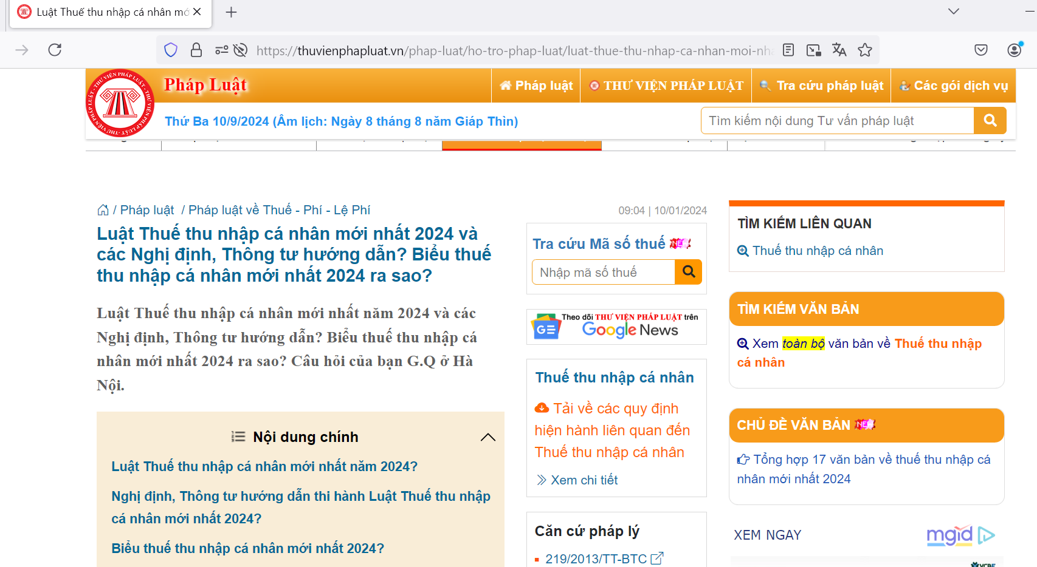
1. Personal Income Tax Requirements
Develop application for PIT management.

Slide 5
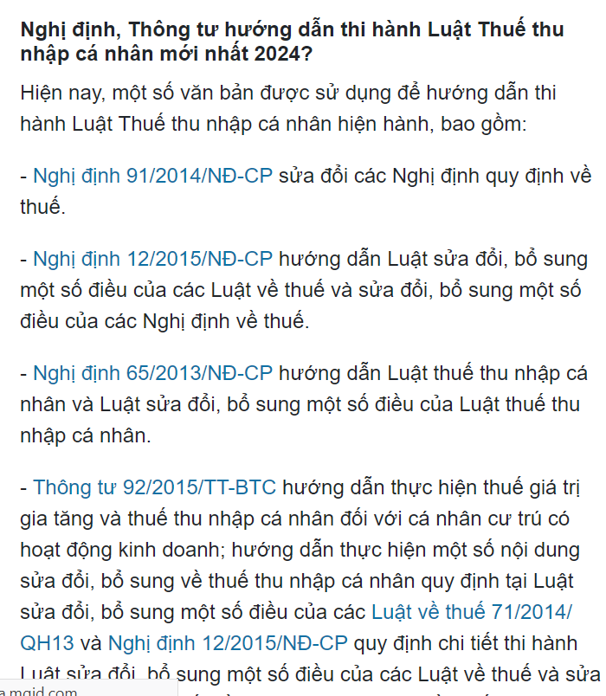
1. Personal Income Tax Requirements
Nghị định, Thông tư

Slide 6
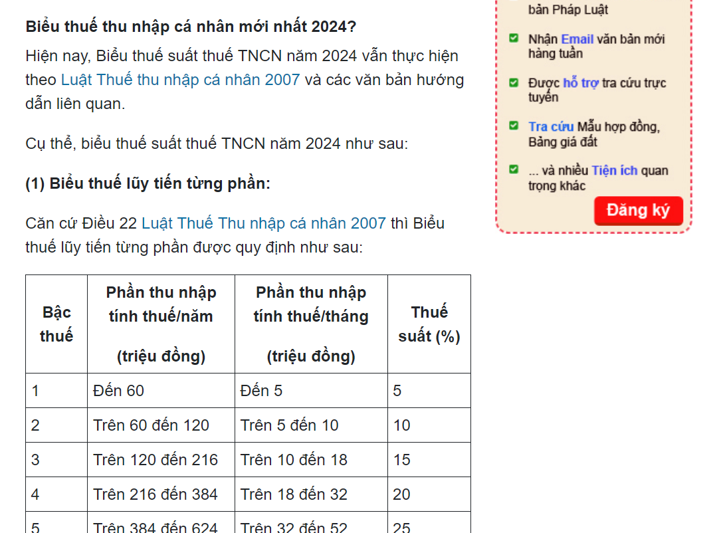
1. Personal Income Tax Requirements
Biểu thuế

Slide 7
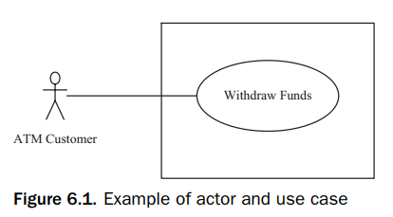
2. USE CASES
In the use case modeling approach, functional requirements are described in terms of actors, which are users of the system, and use cases.
A use case typically consists of a sequence of interactions between one or more actors and the system. Each interaction consists of an input from the actor followed by a response from the system
The use case model describes the functional requirements of the system in terms of the actors and use cases. The system is treated as a black box – that is, dealing with what the system does in response to the actor’s inputs, not the internals of how it does it.

Slide 8
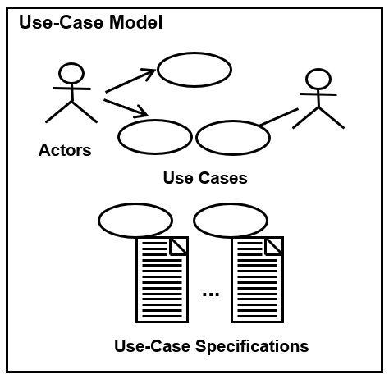
Use case model
The use case model includes use case diagrams and use case specifications.

Slide 9
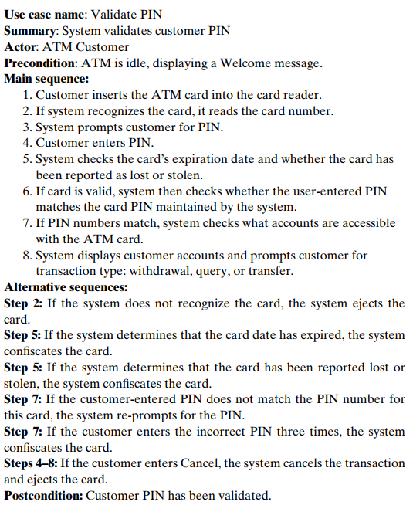
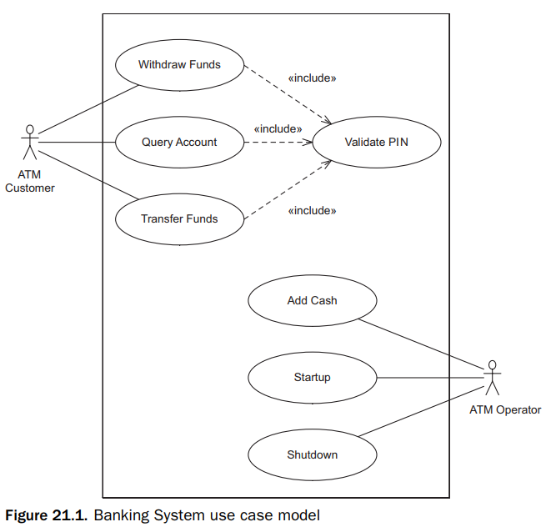
Example use case model

Slide 10
3. Actors
An actor characterizes an external user (i.e., outside the system) that interacts with the system.
An actor represents a role played in the application domain, typically by a human user. In addition, an actor can be an external system, input/output device, or timer.
The primary actor initiates the use case with input from the primary actor and derives the main value from it.
Other actors are secondary actors that can participate in the use case. Other software systems often serve as secondary actors, contributing behind the scenes to the use case execution.
The relationship between an actor and a use case is an association (with/without an arrow).
An arrow from an actor to a use case indicates that he is the primary actor for the use case. An arrow goes from a use case to a secondary actor.

Slide 11
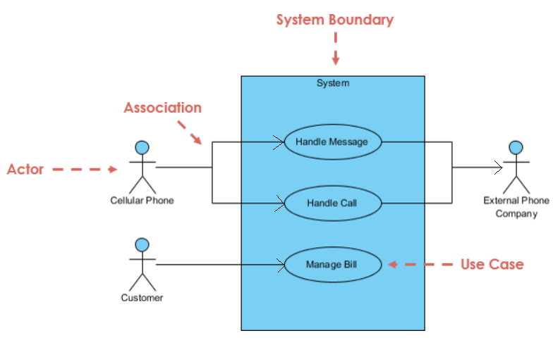
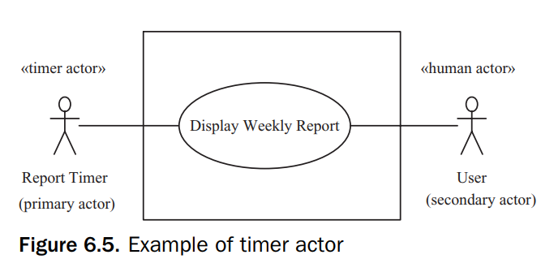
3. Actors

Slide 12
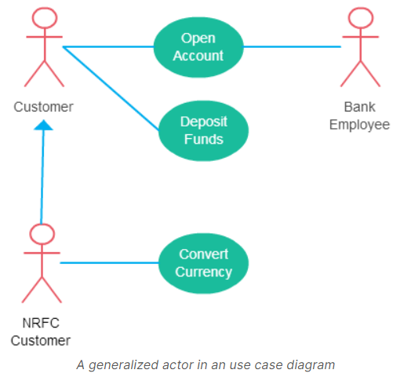
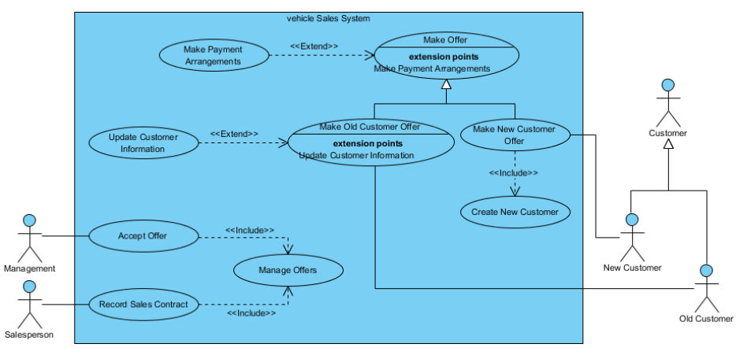
Relationships between Actors
A human user can play two or more independent roles, this is represented by a different actor for each role.
Different actors might have some roles in common but other roles that are different. In this situation, the actors can be generalized, so that the common part of their roles is captured as a generalized actor, and the different parts by specialized actors.
Generalization of an actor means that one actor can inherit the role of the other actor

Slide 13
Identify Actor
Who uses the system?
Who installs the system?
Who starts up the system?
Who maintains the system?
Who shuts down the system?
What other systems use this system?
Who gets information from this system?
Who provides information to the system?
Does anything happen automatically at the present time?

Slide 14
4. Identifying use cases
To determine the use cases in the system, it is useful to start by considering the actors and the interactions they have with the system.
The following questions can be asked to identify use cases, once your actors have been identified :
What functions will the actor want from the system?
Does the system store information? What actors will create, read, update, or delete this information?
Does the system need to notify an actor about changes in the internal state?
Are there any external events the system must know about? What actor informs the system of those events?
The names of use cases are always written in the form of a verb followed by an object.
User management
=> Manage users

Slide 15
5. Use case relationships
When use cases get too complex, dependencies between use cases can be defined by using the include, extend, and generalization relationships.
Use case generalization is similar to the extended relationship because it is also used for addressing variations. However, users often find the concept of use case generalization confusing.

Slide 16
5.1 The include relationship
Use case include is a directed relationship between two use cases which is used to show that behavior of the included use case (the addition) is inserted into the behavior of the including (the base) use case.
Some use cases can have common sequences of interactions that reflect functionality that is common to more than one use case. A common interaction sequence can be extracted from several of the original use cases and made into a new use case, which is called an inclusion use case.
When this common functionality is separated into an inclusion use case, this use case can now be reused by other use cases.
Inclusion use cases always reflect functionality that is common to more than one use case. When this common functionality is separated into an inclusion use case, the inclusion use case can be reused by several base (executable) use cases.

Slide 17
5.1 The include relationship
Execution of the included use case is analogous to a subroutine call or macro command in programming. All of the behavior of the included use case is executed at a single location in the including use case before execution of the including use case is resumed.
The include relationship could be used:
to simplify large use case by splitting it into several use cases,
to extract common parts of the behaviors of two or more use cases.

Slide 18
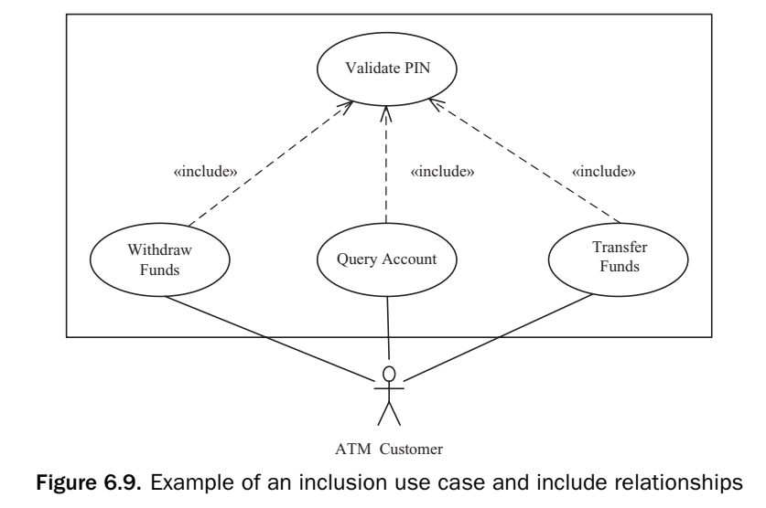
5.1 The include relationship

Slide 19
5.2 Extended Relationship
A use case can get very complex, with many alternative branches. The extended relationship is used to model alternative paths that a use case might take.
A use case can become too complex if it has too many alternative, optional, and exceptional sequences of interactions. A solution to this problem is to split off an alternative or optional sequence of interactions into a separate use case. The purpose of this new use case is to extend the old use case if the appropriate condition holds. The use case that is extended is referred to as the base use case, and the use case that does the extending is referred to as the extension use case.

Slide 20
5.2 Extended Relationship
Extend is a directed relationship that specifies how and when the behavior defined in usually supplementary (optional) extending use case can be inserted into the behavior defined in the extended use case (also called base uc).
Extended use case is meaningful on its own, it is independent of the extending use case. Extending use case typically defines optional behavior that is not necessarily meaningful by itself. The extend relationship is owned by the extending use case. The same extending use case can extend more than one use case, and extending use case may itself be extended.
The extension takes place at one or more extension points defined in the extended use case.
Extend relationship is shown as a dashed line with an open arrowhead directed from the extending use case to the extended (base) use case. The arrow is labeled with the keyword «extend».

Slide 21
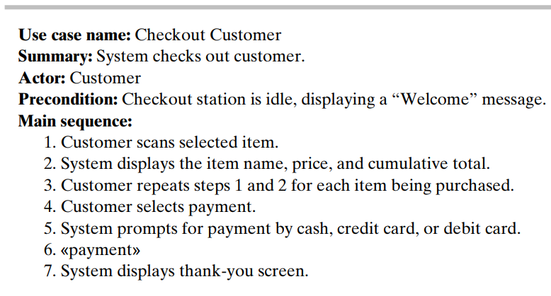
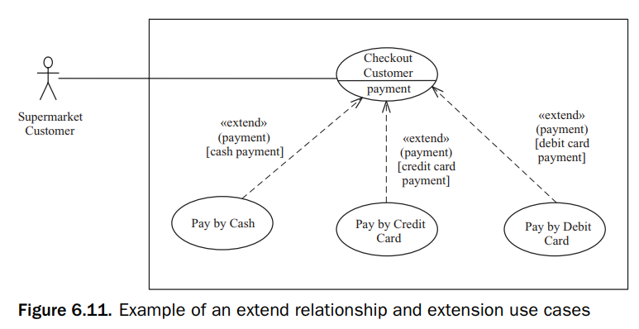
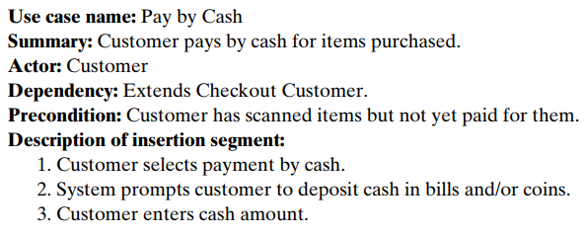
Example
An extension point called payment is declared in a base use case called Checkout Customer
[cash payment]: selection condition

Slide 22
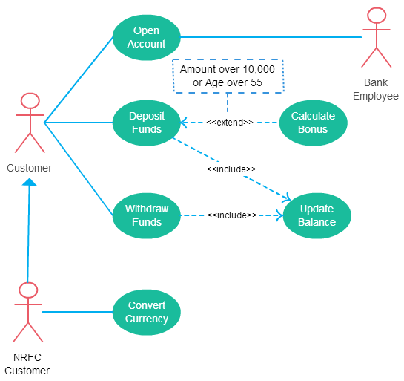
Use case relationship

Slide 23

Dependency relationship
In an e-commerce application, a Cart class depends on a Product class because the Cart class uses the Product class as a parameter for an add operation.
In a class diagram, a dependency relationship points from the Cart class to the Product class. As the following figure illustrates, the Cart class is, therefore, the client, and the Product class is the supplier.

Slide 24
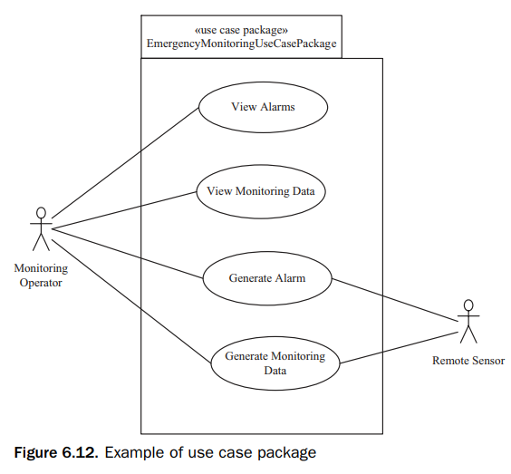
6. Use case packages
Large systems (large number of use cases) can use use-case packages to group together related use cases.
Use case packages can represent high-level requirements that address major subsets of the functionality of the system.
Because actors often initiate and participate in related use cases, use cases can also be grouped into packages based on the major actors that use them.
Nonfunctional requirements that apply to a group of related use cases could be assigned to the use case package that contains those use cases.

Slide 25
7. Activity diagrams
An activity diagram is a UML diagram depicting the flow of control and sequencing among activities
An activity diagram can be used to represent the sequential steps of a use case, including the main sequence and all the alternative sequences
Activity diagrams can also be used to depict sequencing among use cases.

Slide 26
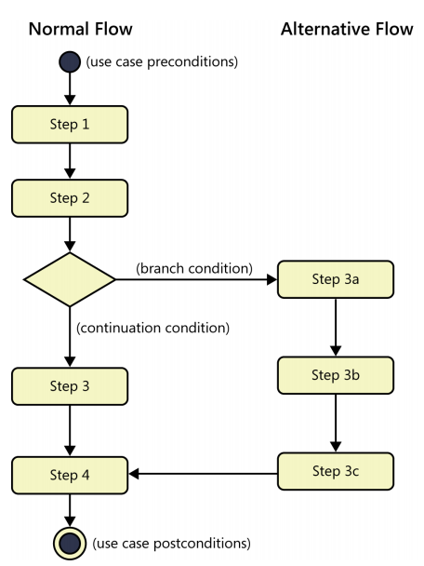
7. Activity diagrams
For depicting a use case, an activity diagram uses activity nodes, decision nodes, arcs to join sequential activity nodes, and loops

Slide 27
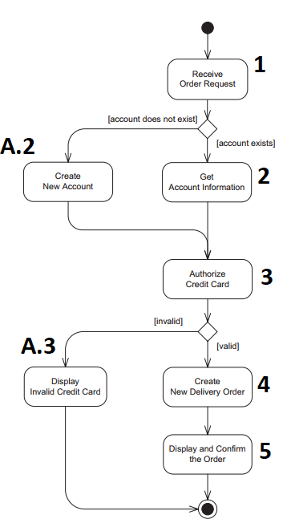
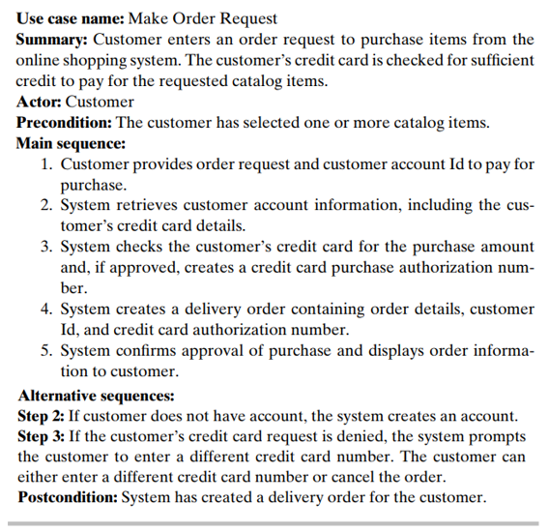
7. Activity diagrams

